Slide 1
Front End Engineering-I Project
Team Details:
NAME ROLL.NO
NIMIT GULATI 2310991915
NITASHA 2310991917
NITPREET SINGH 2310991918
Faculty Coordinator:
Dr.BHISHAM SHARMA
:
Chitkara University Institute of Engineering and Technology,
Chitkara University, Punjab

Slide 2
Abstract
A drawing tool is a software or physical instrument that allows users to create visual representations on various mediums. These tools often provide a range of features, such as selecting colors, brush types, and drawing shapes, to enable users to express their creativity and convey ideas through illustrations and artwork. They are used in various domains, from artistic endeavors to technical design and illustration, making them a versatile means of visual expression.

Slide 3
Table of Contents
Introduction
Problem Statement
Technical Details
Key Features
Project Highlights
Bonus Feature(optional)
Conclusion
References/Links used

Slide 4
Introduction
BLENDING PALETTE - Your ultimate drawing tool for creative blending…..
Which is built by our amazing team members- Nimit Gulati , Nitasha ,Nitpreet Singh.
Welcome to the future of digital creativity! Our innovative drawing tool blending palette redefines artistic expression, allowing you to effortlessly create shapes

Slide 5
and drawings with a variety of pen styles and shapes. This seamless fusion of traditional artistry and technology opens up a world of limitless possibilities. Whether you're a budding artist, an experienced illustrator, or simply a creative spirit, this tool is your ultimate companion. Bid farewell to the constraints of traditional supplies and embrace a realm where your imagination knows no bounds. Discover how every stroke and shape can become a masterpiece in this transformative digital art experience.

Slide 6
Problem Statement
To enhance the creativity of art build of an artist in a digital way to save time and trees..
Introducing our innovative drawing tool, a versatile and feature-packed application designed to empower your creative endeavors. Not only does it provide a seamless platform for unleashing your artistic talents, but it also boasts a powerful document conversion feature.

Slide 7
With the ability to effortlessly transform PDF documents into editable Word files and vice versa, our tool bridges the gap between artistry and productivity.

Slide 8
Whether you're a designer seeking inspiration or a professional needing efficient document management, our tool offers a comprehensive solution to cater to your needs. Welcome to a world where creativity meets functionality – all in one convenient package.

Slide 9
Technical Details
The HTML file defines the user interface, which includes a canvas for drawing, various buttons for actions like clearing the canvas, saving the artwork, using an eraser, and adding text. Users can choose different colors for drawing and adjust the line width. Additionally, there are shape-drawing options such as circles, rectangles, triangles, and squares. Users can select a shape, specify its size, and click on the canvas to draw the selected shape.

Slide 10
This Html document defines the structure of a web page for a drawing tool centered around a canvas element. The head section includes metadata such as the character set, viewport configuration, and the title "Blending Palette." It also references external resources, namely a stylesheet ("style.css") for styling and a script ("script.js") for additional functionality, set to load asynchronously.

Slide 11
The body of the page contains a canvas element with the ID "canvas," serving as the primary drawing area. The navigation section ("nav") encompasses various color options represented as div elements with class "clr" and data attributes specifying the color values. Additionally, there are buttons for clearing the canvas, saving the drawing, activating an eraser, adding text, and undoing or redoing actions. The "brushType" select element allows users to choose between different drawing tools, and an input type color

Slide 12
and range are provided for selecting color and adjusting brush size, respectively.
Furthermore, there's an emoji div displaying an image ("Paint.png"), and a container with a button linking to another page ("backupfp.html"). The footer section includes buttons for drawing shapes (circle, rectangle, triangle, square) with corresponding input elements for adjusting their sizes. Overall, this HTML document establishes the foundation for a feature-rich drawing tool with diverse options for color, brushes, shapes, and other functionalities.

Slide 13
The CSS file styles the user interface elements, providing a visually appealing design with responsive behaviour. It includes color selection options and style changes for buttons and shapes.

Slide 14
The provided CSS stylesheet defines the visual styling and layout properties for a web page implementing a drawing tool. The universal selector sets default margin, padding, overflow, and font-family properties for all elements. The canvas class is intended to center the canvas, although the corresponding HTML element lacks this class. The canvas itself ("#canvas") is styled with a fixed display, a background image, and a linear gradient background.

Slide 15
The navigation bar ("nav") is given a fixed position at the top, with a gradient background and rounded borders. The color options ("clr") within the navigation bar have defined styles, including a circular shape, border, hover transformation, and specific background colors. The buttons in the navigation bar also share a consistent design with a background color, font styling, and hover effect.

Slide 16
Additional styling includes specific designs for buttons like "text" and "shape," each with distinct background colors and hover effects. The "save" button has a unique background color as well. Input elements, such as the color picker and range input, have defined widths and heights. The footer has a fixed position at the bottom, with similar gradient background and border styles as the navigation bar.

Slide 17
Selectors for undo and redo buttons are provided, although the associated HTML elements are not present. The stylesheet also includes styles for the "emoji" class, setting the font size and padding. Lastly, the "body" selector within the "undo" and "redo" sections appears to be a mistake, as it doesn't follow the correct syntax, and these sections are included within the curly braces of the button:hover property. Overall, the stylesheet is designed to create a visually appealing and functional interface for a drawing tool with a variety of features.

Slide 18
The JavaScript code handles user interactions and canvas drawing operations. It tracks the selected color, line width, and shape, allowing users to draw and add shapes to the canvas. It also supports actions like clearing the canvas and saving the artwork as an image. There's even an undo feature that can be extended for further functionality.

Slide 19
This JavaScript code orchestrates the functionality of a drawing tool implemented in a web page. The script retrieves the canvas element and sets its dimensions to match the window size. It establishes event listeners for various user interactions, such as changing colors, adjusting line width, and handling mouse movements for drawing on the canvas. Additionally, the script manages functionalities like clearing the canvas, saving the drawing as an image, and enabling an eraser.

Slide 20
The script supports the creation of basic geometric shapes (circle, rectangle, triangle, square) on the canvas, allowing users to select the shape and adjust its size through corresponding input elements. The code also includes functionality for a custom select box with icons, providing users with options for different drawing tools like pencil, brush, and spray paint.
Furthermore, the script tracks the drawing history, allowing users to undo and redo actions. The "performAction" function, while incomplete,

Slide 21
suggests an intention to implement a feature to add a square element to the canvas as part of the drawing history.
Overall, this JavaScript code provides a comprehensive set of features for a drawing tool, combining color selection, line width adjustment, shape drawing, and the ability to undo and redo actions. The code is structured with clarity, utilizing event listeners and functions to manage user interactions and maintain the drawing state.

Slide 22
Key Features
Canvas Drawing: Users can create drawings on an HTML canvas with various line thicknesses and colors, making it suitable for both artistic and practical applications.
Color Palette: A color palette allows users to select their preferred drawing color from a range of options, including a custom color picker.

Slide 23
Brush Shapes: Users can choose from different brush shapes, such as pencil, brush, and spray paint, enhancing creativity and versatility.
Shape Drawing: The tool supports drawing basic shapes like circles, rectangles, triangles, and squares, with adjustable sizes and colors.
Eraser: An eraser function lets users easily remove unwanted strokes.

Slide 24
Text Addition: Users can add text to their drawings, facilitating annotations and labeling.
Undo/Redo: The undo and redo buttons enable users to correct mistakes or revisit previous changes.

Slide 25
Saving: Users can save their drawings as PNG images for later use or sharing.
Navigation: The user-friendly interface includes a navigation bar with clear buttons for various actions, making it accessible and intuitive.

Slide 26
Customisation: Users can customise line thickness and background color, enhancing the personalisation of their drawings.
Responsive Design: The tool is designed to work across different screen sizes and devices.

Slide 27
Bonus Feature(optional)
Along with the drawing tool with many artistic
features.We have also added the options to
pdf document to word document and word
document to pdf document for a better user
experience and user satisfaction unlike other
drawing tools we can also access all those
features at once .

Slide 28
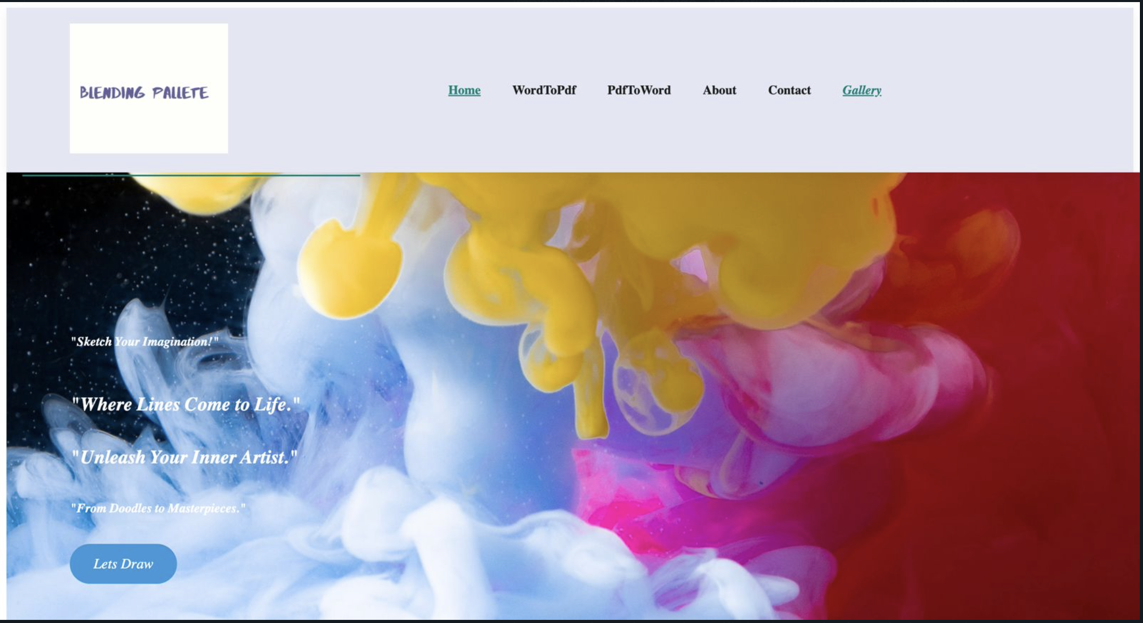
Project Highlights

Slide 29
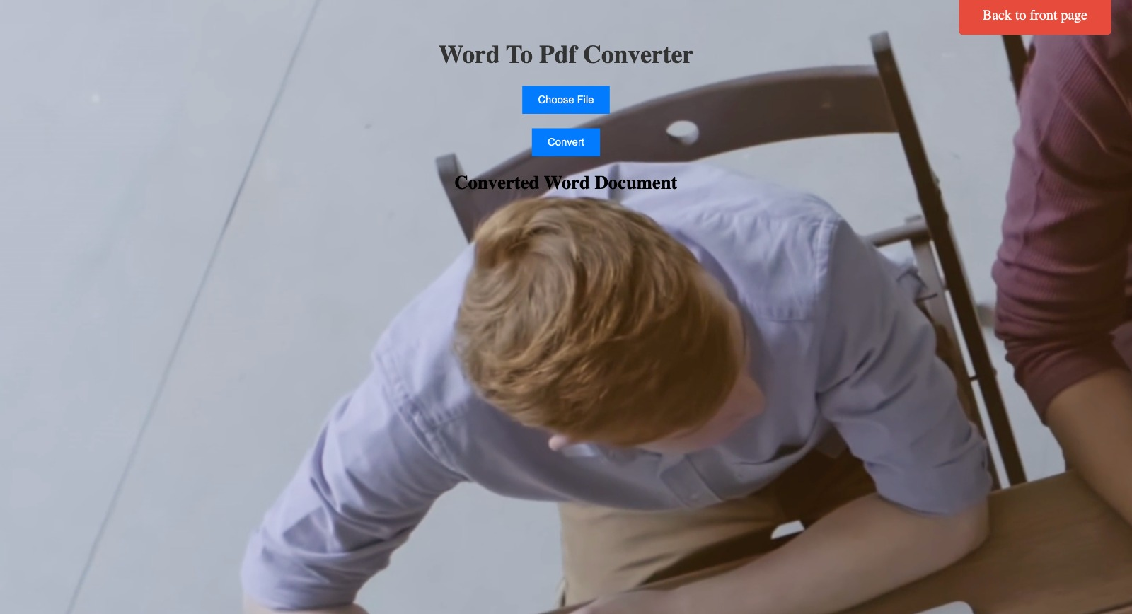
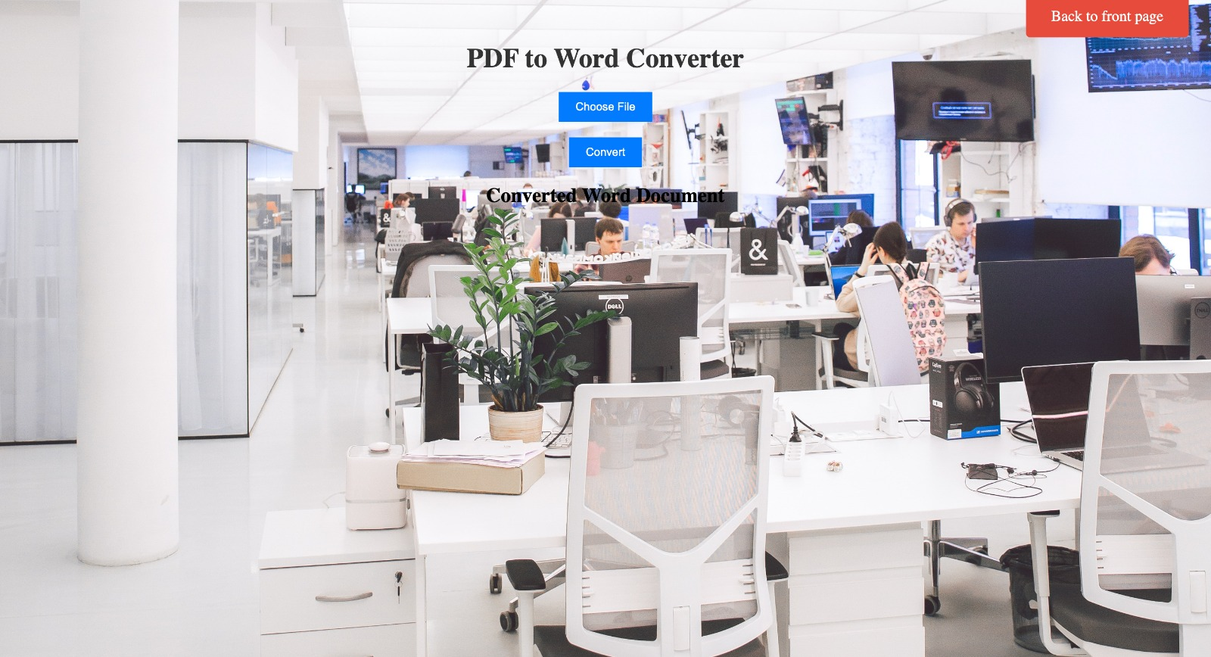

Slide 30
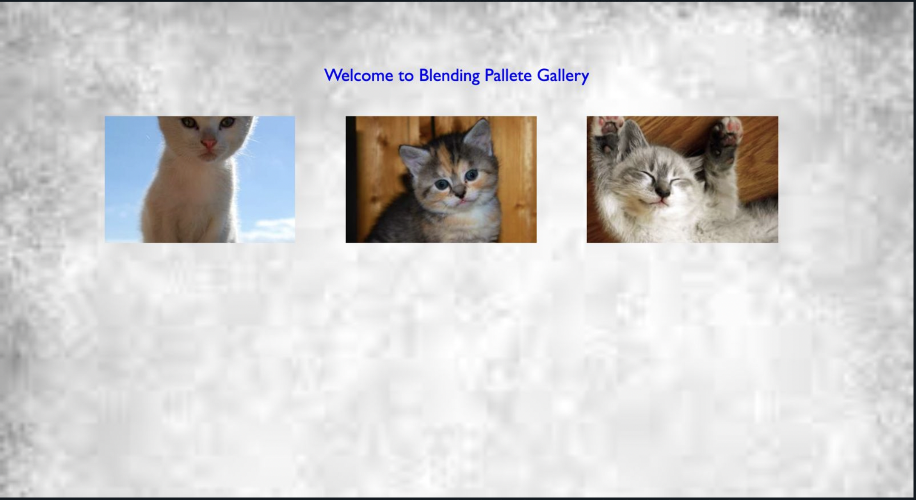

Slide 31
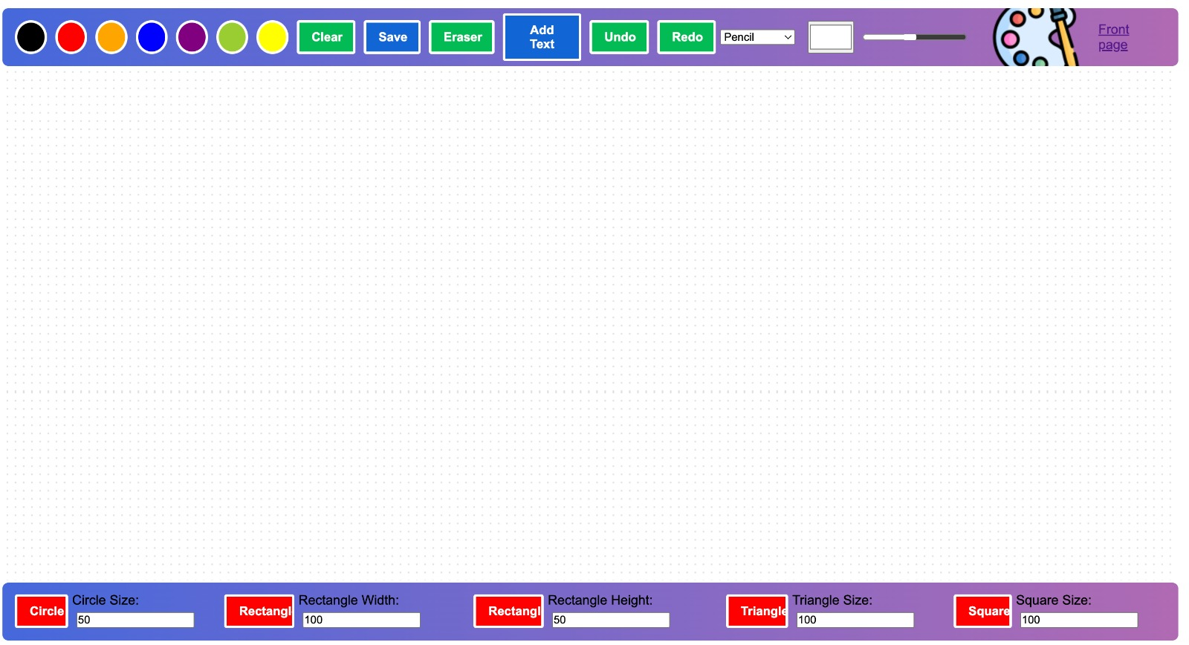

Slide 32
Conclusion
In conclusion, our drawing tool, known as the Blending Palette, is a dynamic gateway for users to express their creative visions and convey ideas through captivating visual representations. Whether in the form of software or a physical instrument, this tool empowers artists, designers, and creators across various domains.
The Blending Palette offers a multitude of features, including canvas drawing with customizable line thicknesses and colors, a versatile color palette, and an array of brush shapes, from pencils to spray paint. Users can effortlessly draw basic shapes, add text to their creations, and utilize the eraser for precise editing. Furthermore, the tool supports undo/redo functionalities, ensuring that no creative idea is lost.

Slide 33
Saving drawings as PNG images is made simple, and the responsive design guarantees that users can unleash their creativity on any device. The user-friendly interface, coupled with customization options for line thickness and background color, enhances the personalization of artworks.
As a bonus feature, we've integrated document conversion capabilities, allowing users to transform PDFs into editable Word documents and vice versa. This holistic approach distinguishes our tool, offering a one-stop solution for both creative and document-related tasks.

Slide 34
The Blending Palette is not just a drawing tool; it's a platform that transcends traditional boundaries, fostering artistic expression and practical utility in a harmonious blend of art and technology. In the ever-evolving digital landscape, our tool empowers users to explore endless creative possibilities while contributing to environmental sustainability through the reduction of paper consumption.
It's a testament to the synergy between creativity and technology, and it's designed to cater to the diverse needs of users in the digital age, ensuring a seamless and satisfying user experience for artists, professionals, and enthusiasts alike. With the Blending Palette, every stroke becomes a story, and every shape is a canvas for the soul's expression.

Slide 35
References/Links used
Image source :- pexels.com
HTML,CSS and JAVASCRIPT :- Took a bit help from youtube and examined other drawing tools such as sketchpad , etc.

Slide 36


